Slide 1
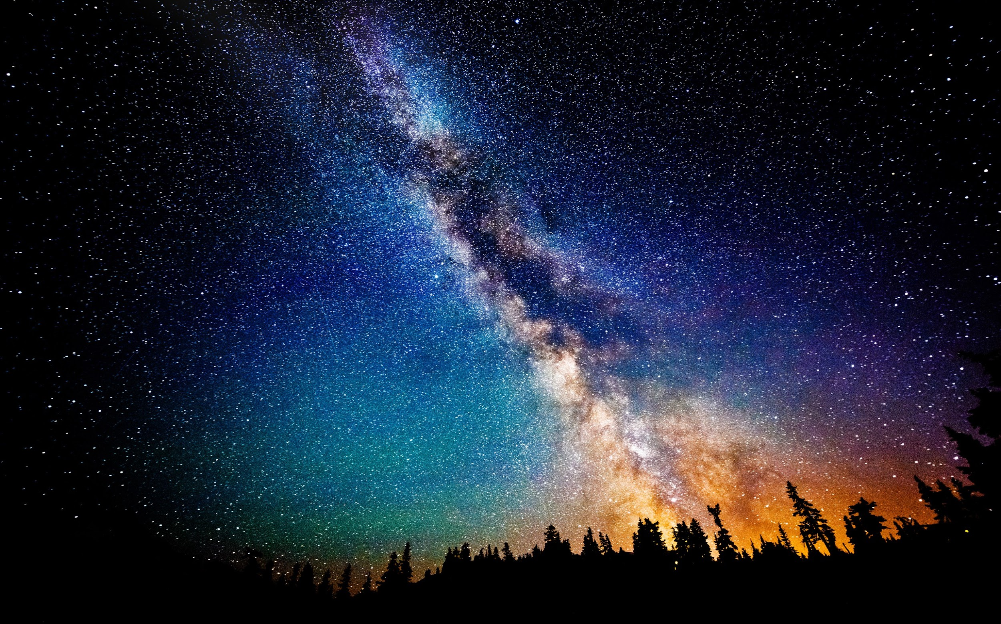
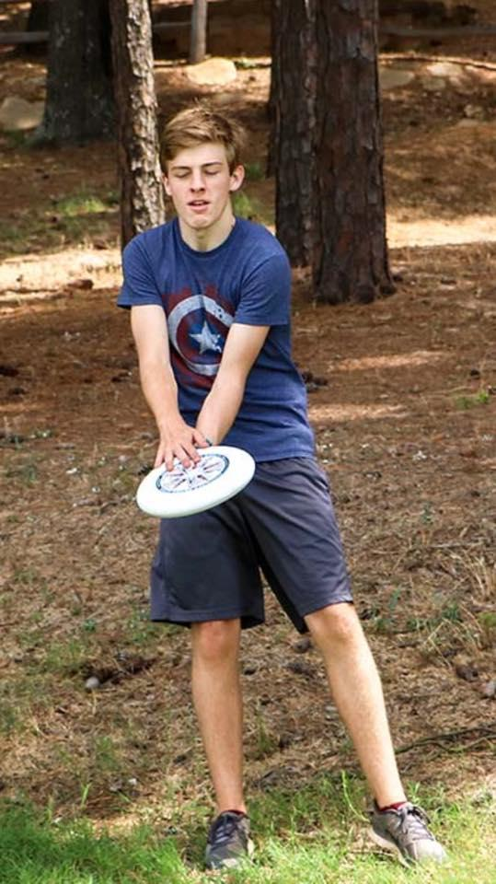

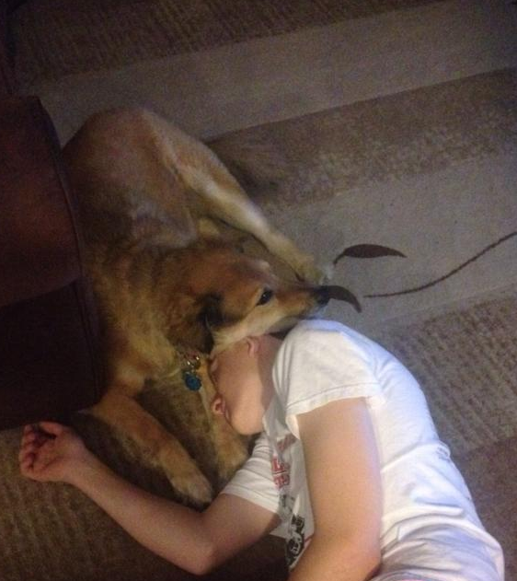

“Do you know Jacob Greenly, the Aerospace Engineer???”
-Sooooo many people
Fav memory: getting pranked haaaaaard
Pledge name:

